Slide 1
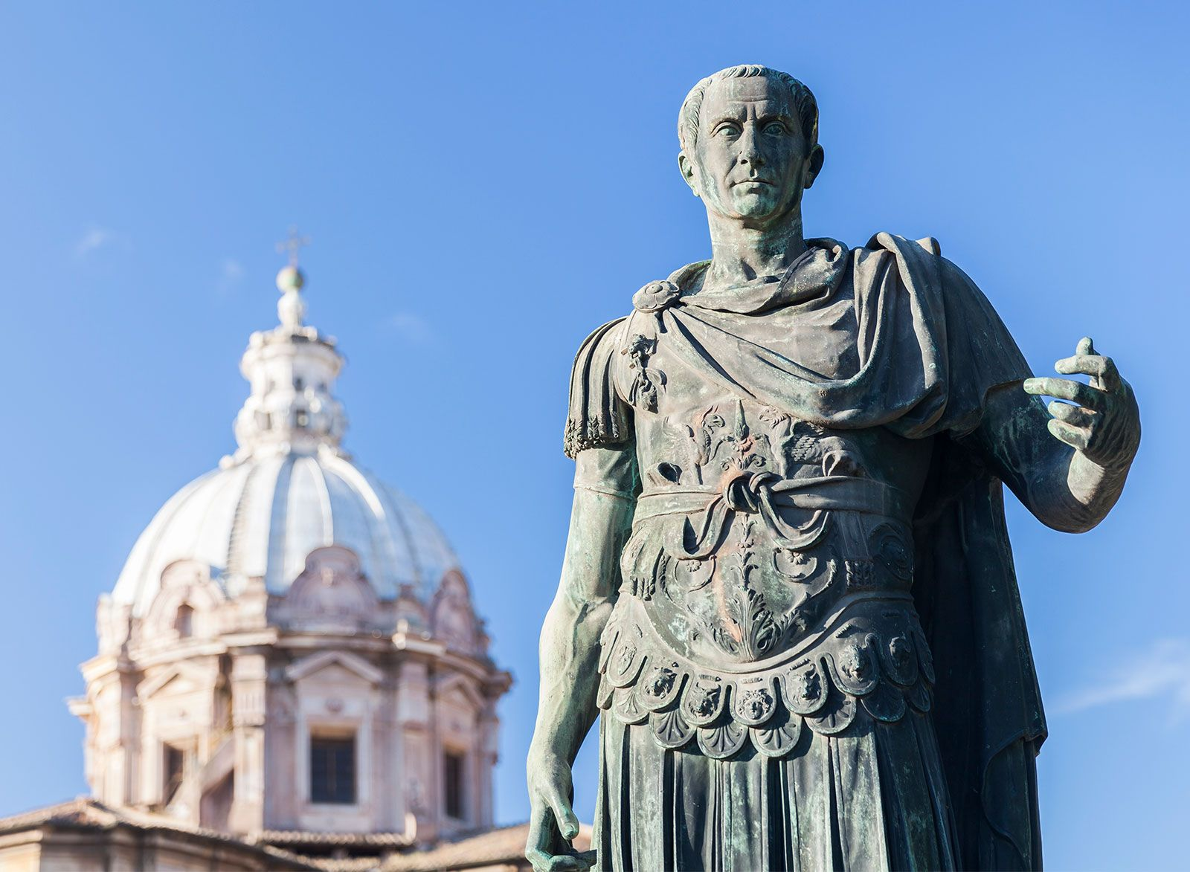
Caesar’s Civil War
- Identify and explain the events of the Civil War
Week 7 Lesson 3
Ms Barrie

Slide 2

Caesar’s Illegal Actions
Caesar to be elected as one of the consuls for 59 BCE - used his new political position to give Pompey and Crassus what they needed.
Caesar had ignored the Senate entirely and relied upon the voting power of the People’s Assembly – unorthodox; not illegal
What got Caesar in trouble, however, was that he relied upon Pompey’s soldiers to use violence to force the Assembly to vote in the way he wanted.
= highly illegal
= Senate wanted to arrest Caesar and put him on trial for these crimes
ESCAPES TO GAUL - 58 to 56 BCE, Caesar enjoyed continuous military success during his Gallic Wars.
The Senate was angry but were willing to wait to get Caesar. To continue to protect himself, Crassus and Pompey met with Caesar again to renew their alliance and grant Caesar an additional five years to his command

Slide 3
The Triumvirate Falls Apart
After the renewal of the First Triumvirate, things gradually started to fall apart for Caesar
Ally – Crassus - killed on military campaign in Parthia in 53 BCE, which left only Pompey
Caesar in Gaul - Pompey had remained in Rome and had developed closer ties with the Senate (instead of Caesar)
By 50 BCE, the Senate encouraged Pompey to no longer protect him.
As a reward, the Senate made Pompey the supreme commanders of their armies and the most powerful man in Rome.
Caesar once more asked Pompey to find a way to protect him from prosecution from the Senate – Pompey refused
Pompey commanded Caesar to give him his armies at the start of 49 BCE and return to Rome as a civilian to face charges for illegally tampering with the Roman political system.
Caesar knew that he had very few options available to him. If he complied with Pompey’s demands, he would certainly be found guilty at trial and be imprisoned for life, or worse.
At the very least, it was the end of the political career.

Slide 4
ACTIVITY – Caesar’s Civil War
Create a mindmap about Caesar’s Civil War

Slide 6
Teacher ONLY – Crossing the Rubicon
End of 50 BCE - Caesar marched his army from Gaul to northern Italy.
They stood at the banks of the Rubicon River, which marked the edge of his territory of military control.
He was not permitted to operate an army south of this river.
At the Rubicon, Caesar gave a speech to his men and outlined the fact that he was facing legal action and imprisonment.
He explained that if this was to happen, his men would lose all of the benefits he had promised them as commander.
Caesar called on his forces to protect him from the Senate. With shouts of encouragement, Caesar led his troops across the river and into Italy on the 10th of January 49 BC.
This was another illegal action from Caesar. He was not permitted to command an army in Italy.
This was now an act of war: Caesar was marching to Rome itself to seize control of the Senate and get rid of his political enemies, as Sulla had done decades before.

Slide 7
Teacher ONLY – Civil War Begins
Caesar knew that he had to move quickly and headed towards Rome. However, Pompey knew that his army was not as experienced or prepared as Caesar’s Gallic legions
He needed more time to raise a larger force and to sufficiently train them.
So, Pompey decided to leave Italy and head to Greece, where he knew he had a larger support base.
There, he would recruit new forces with the intention of re-invading Italy. The optimates senators knew that it would be suicidal to be in Rome when Caesar arrived, so they fled with Pompey towards the coastal town of Brundisium.
When Caesar heard of the escape plan, he headed towards Brundisium as well. He hoped to catch his enemies before they were too far away.
However, by the time he arrived there in March 48 BC, Pompey and the Senate had already left for Greece.
In the absence of any other leadership, Italy surrendered itself to Caesar. It had only been 66 days since the war had begun.
Caesar then received word that troops loyal to Pompey were prepared to attack from Spain.
Making a strategic decision to leave Pompey in Greece, Caesar marched his troops west to Spain to deal with the new threat.

Slide 8
Teacher ONLY – War In Spain
When Caesar landed in Spain, he was already at a disadvantage. Pompey’s troops there were experienced soldiers who were fighting on home soil.
In addition, heavy rains had made many rivers and plains made things difficult for armies to camp or march.
The Pompeian troops knew that they only had to fight a defensive war to force Caesar’s troops to exhaust themselves.
This would grant them a relatively easy victory and win the civil war for Pompey. Caesar’s only option was to move quickly and force his enemies to face his more experienced troops on the battlefield.
By chance, Caesar managed to capture some of his enemy’s scout troops, who told him about a planned night attack.
Using this information, Caesar counter-attacked and won a clear victory. The remaining Pompeiian troops were trapped on a hill without food and water.
With no other option, they surrendered to Caesar.
With their surrender, Spain fell to Caesar and his troops. The quick movements and decisive action of Caesar’s men had achieved a victory quicker than anyone imagined.
So, with this threat neutralised, Caesar headed back to Italy to prepare to chase after Pompey again.

Slide 9
Teacher ONLY – War In Greece
Back in Italy in late 49 BC, Caesar learnt that Pompey’s ships had blockaded the Italian ports, which had cut off food supplies.
People were beginning to starve, and public opinion was turning against Caesar. What made things worse was that winter was about to begin, which meant that the people could not survive for much longer.
Needing a quick solution, Caesar decided to invade Greece. However, crossing the Adriatic Sea between Italy and Greece in winter was dangerous.
Ships often sank in the unpredictable sea. As a result, Pompey did not think Caesar would attempt such a crossing until Spring. So, Pompey failed to watch the seas, which allowed Caesar to land his troops in Greece with little resistance.
When Pompey learned of Caesar’s landing in Greece in early 48 BC, Pompey rushed his army west to engage him. The two forces met near the town of Dyrrachium in July 48 BC, where both sides built siege works against each other.
This led to a stalemate, with neither side able to take the upper hand. So, Pompey launched a major assault, which managed to break through Caesar’s wooden barricades. Caesar withdrew but Pompey chose not to pursue him. This gave Caesar time to reorganise his men and prepare for another attack.
The optimates senators were disappointed that Pompey had let Caesar escape and pressured him into forcing another battle.
However, Pompey was concerned that new troops were still not ready. Regardless, he followed the optimates’ demands and prepared to fight Caesar near the city of Pharsalus in Greece on the 9th of August 48 BC.
During the battle, Pompey's cavalry was easily outmatched by Caesar’s and fled from the battlefield.
Caesar’s veteran infantry then charged Pompey’s new recruits. Much to Pompey’s surprise, his men did not flee.
However, when Caesar’s troops were able to encircle them, due to the absence of the cavalry, Caesar's legions easily cut their enemy down.
So, despite having a larger army, Pompey lost the Battle of Pharsalus.

Slide 10
Teacher ONLY – End of the Civil War
While he had lost the battle, Pompey had fled early enough that he had not been captured.
Realising that Greece was not safe, Pompey fled for Egypt, where he hoped to rely upon the support of the young pharaoh Ptolemy XIII.
Unfortunately for Pompey, as he stepped off his boat in Alexandria in September 48 BC, he was killed by the pharaoh’s advisors.
The assassins were hoping to win Caesar’s appreciation. However, a few days later, when Caesar arrived in Egypt, he was saddened to find out that his opponent had met his end in such an unheroic manner.
Caesar remained in Egypt and became involved in a civil war between Ptolemy XIII and his sister, Cleopatra VII.
Caesar supported Cleopatra who overthrow Ptolemy as pharaoh in 47 BC. Cleopatra and Caesar became romantically involved and she gave birth to his son.
This meant that Caesar could count Egypt as one of his allies in the future.
When Caesar was due to leave Egypt, he had to respond to a threat from Pontus. King Pharnaces II had used the civil war between Caesar and Pompey to invade the Roman provinces of Asia Minor.
Caesar took his troops there, and, in a decisive battle at Zela in 47 BC, Pharnaces was defeated. This brought peace back to the region.
However, even though Pompey was dead, resistance against Caesar continued. Pompeian troops still remined in northern Africa.
Caesar returned to Italy in September 47 BC, and then launched an attack on north Africa in 46 BC. He finally defeated his enemies at the city of Thapsus.
Two of Pompey’s sons had escaped to Spain and continued the resistance there. Caesar traveled to Spain once more and defeated them in 45 BC.
Julius Caesar finally returned to Rome in October 45 BC, with all Pompeian resistance gone.
The civil war could now be declared over, and Caesar had become the most powerful man in the Roman world.

Slide 11
Consequences
The fact that Pompeian troops continued to resist Caesar for up to three years after Pompey’s death shows that the conflict was not really about individual people.
The war was about fundamental differences in the political beliefs of the optimates and populares.
All of the problems that had existed since the days of the Gracchi brothers had never been resolved and had only magnified the power of ambitious men.
The war between Caesar and Pompey was almost inevitable as the political divisions between senators failed to find a solution that did not continually rely upon military intervention.
Even after Julius Caesar died, the problems would arise once more. It would take the collapse of the entire republican political system before the Roman world could find an alternative solution to these issues.
Notes:
The two groups differed, therefore, chiefly in their methods: the Optimates tried to uphold the oligarchy; the Populares sought popular support against the dominant oligarchy, either in the interests of the people themselves or in furtherance of their own personal ambitions

